Slide 1
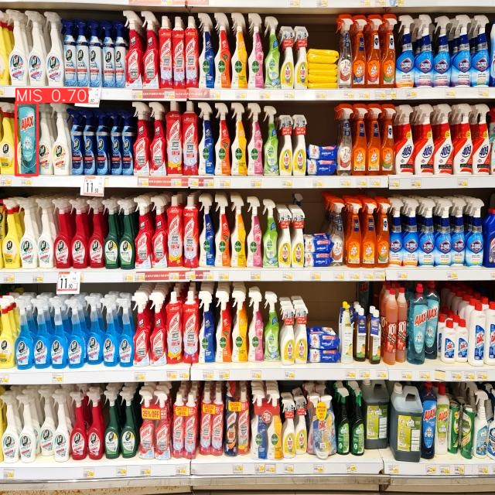

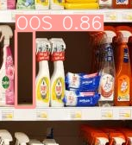
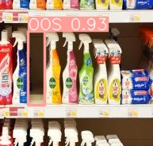
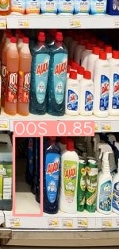
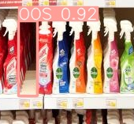
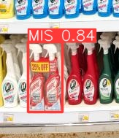
231-ICS-619 Project Video-based Retail Store Shelf Monitoring
Khaled Almutairy
Mamoun Alghaslan

Slide 2
Team
Mamoun
Khaled
Title
Title

Slide 3
Introduction
Seamless, Saudi Arabia's premier event, highlighted innovations in payments, fintech, retail, e-commerce, home delivery, and digital marketing.
A focus on retails future featured cashier-less stores showcasing AI-powered shelf monitoring, addressing a key industry trend.

Slide 4
Challenges in Retail Inventory Management
Manual Inspection Process: relying on labor-intensive manual work, with employees counting and correcting products on shelves, preparing OOS inventory, retrieving items from storage, and replenishing shelves.
Financial Implications: High expenditure on inventory management and potential customer loss due to frustration or simply not finding the convenience

Slide 5
Challenges in current approaches
Limitations of traditional methods (ML, image processing)
Deep learning's need for large annotated datasets
Difficulty in achieving high precision for Out-Of-Stock detection due to shelf layout, object shapes, and occlusion.

Slide 6
Our proposed approach
Collecting images directly from shelves
Labelling products and empty spaces with bounding boxes
Fine-tuning a pre-trained object detection model on a supermarket dataset
Building an efficient system around the detection model

Slide 7

Background & existing solutions

Slide 8
Background
Object Detection and Recognition
Model Implementation Options
Detection involves locating and defining the best bounding box
Recognition refers to classification
Traditional Image Processing such HOG, SIFT, SURF, BRISK and FAST
Deep Learning Networks

Slide 9
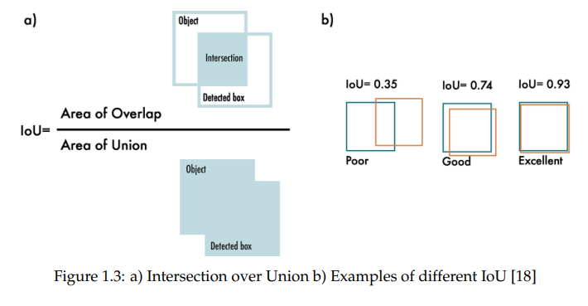
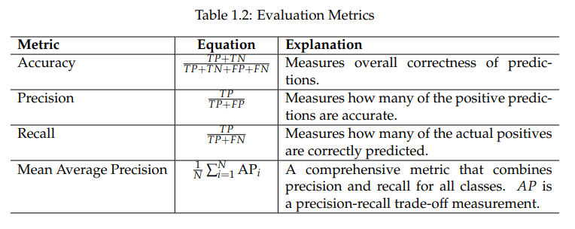
Metrics
Object Detection
Object Recognition

Slide 10
Existing Solutions
Deep Learning methods
Other methods
Soft-IoU
EM-Merger unit
YOLO
Classical Methods
Depth Estimation Method

Slide 11
Data Collection & Expreiments

Slide 12
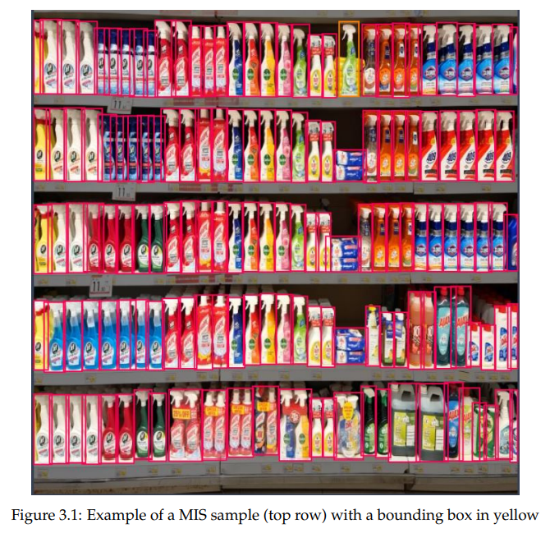
Data Collection
Danube Supermarket
Focused on five shelves ~150 products
Each product was removed to simulate OOS, and 32 product were moved around five times to simulate MIS
A total of 310 images were collected and augmented
Data set was split 90/5/5%, with 15 samples of OOS and MIS in val./test
Roboflow for annotation

Slide 13
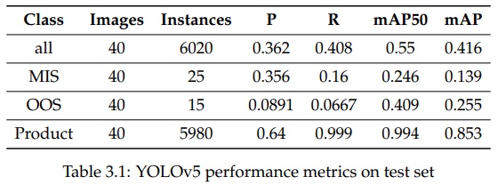
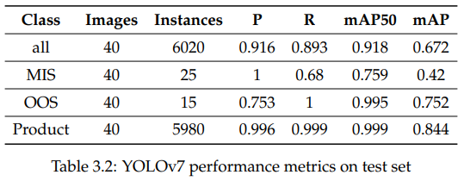
Experiments
YOLOv5
YOLOv7
Paperspace Jupyter Notebook, Quadro-P600 GPU, ~5 hours training

Slide 14
System Design

Slide 15
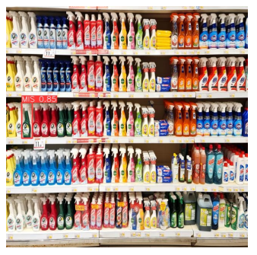
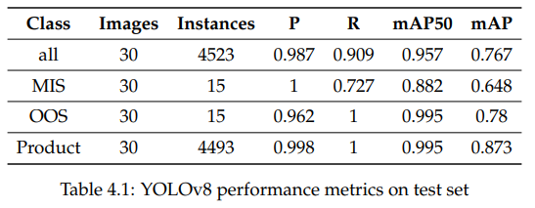
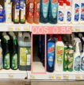
Model fine-tuning
YOLOv8
Results

Slide 16
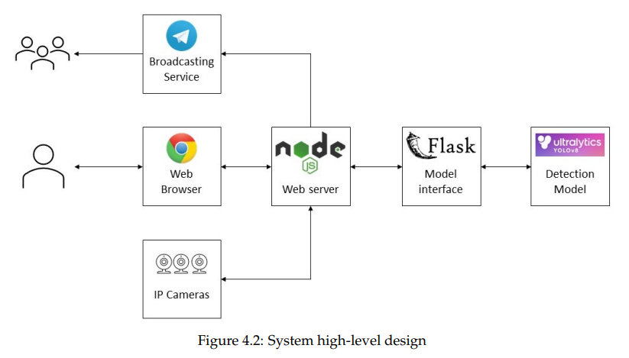
System Design
Components
Diagram
Detection model
Model API
Web Server
Web-site server
Web worker
Broadcasting service
IP Cameras

Slide 17
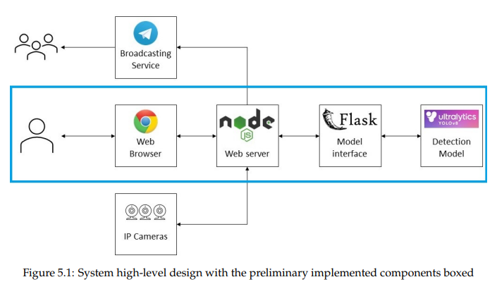
Prototype
Design
Implemented Components
Web server: Node.js + Express
Model server: Python + Flask

Slide 18
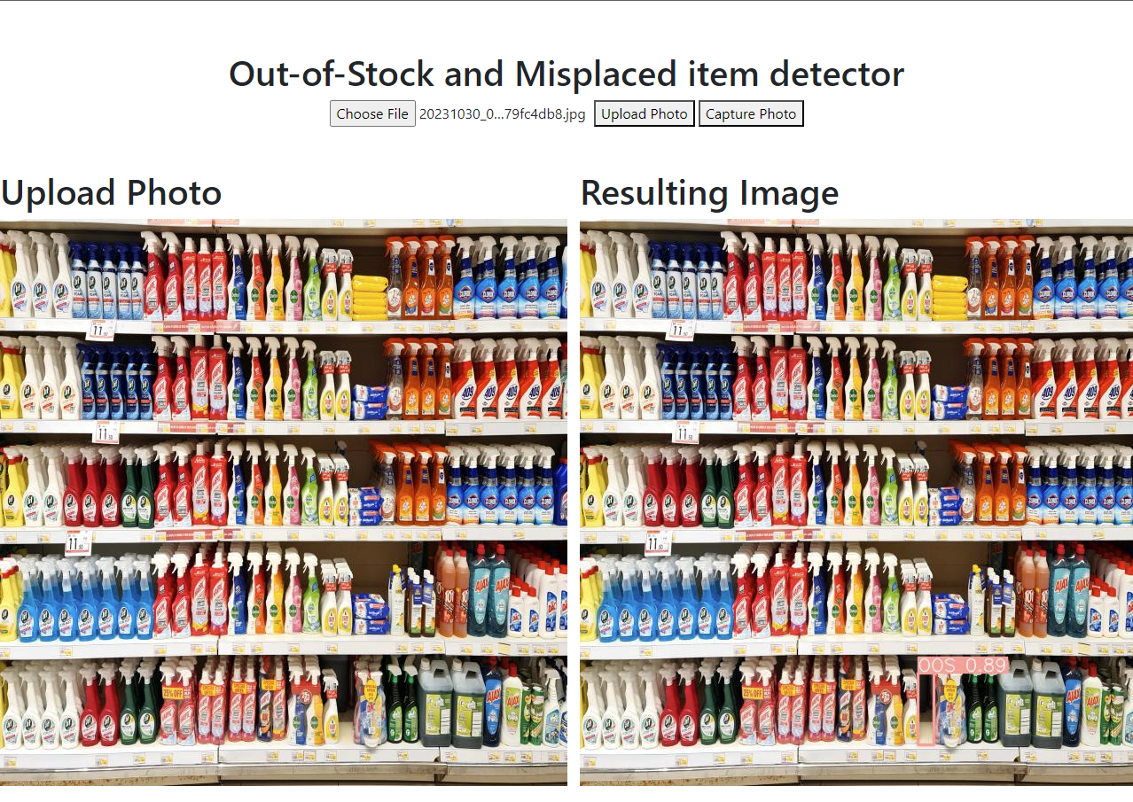
Prototype

Slide 19

Conclusion
In this project, we developed a Video-based Retail Store Shelf Monitoring System (SMS) using deep learning, addressing Out-Of-Stock (OOS) and product misplacement challenges in retail inventory management. We created a dataset from Danube supermarket and demonstrated the system's high performance, achieving mean Average Precision (mAP) scores of 0.882 for MIS and 0.995 for OOS using YOLOv8. The prototype showcases the system's feasibility, and future work focuses on real-world testing, refining accuracy, scalability, and integration with retail management systems, with an aim to provide a robust tool adaptable to evolving retail industry needs.

Slide 20
Project Plan
Title
To start a presentation, go to the Slide Show tab, and select From Beginning.
Title
To display Presenter view, in Slide Show view, on the control bar at the bottom left select the three dots, and then Show Presenter View.
Title
During your presentation, the speaker notes are visible on your monitor, but aren't visible to the audience.
Title
The Notes pane is a box that appears below each slide. Tap it to add notes.
Title
If you don’t see the Notes pane or it is completely minimized, click Notes on the task bar across the bottom of the PowerPoint window.

Slide 21


Agenda
Topic one
Topic two
Topic three
Topic four

Slide 22
Introduction
With PowerPoint, you can create presentations and share your work with others, wherever they are. Type the text you want here to get started. You can also add images, art, and videos on this template. Save to OneDrive and access your presentations from your computer, tablet, or phone.

Slide 24
Topic One
Subtitle

Slide 25
Chart

Slide 26
Table
 | Category 1 | Category 2 | Category 3 | Category 4
Item 1 | 4.5 | 2.3 | 1.7 | 5.0
Item 2 | 3.2 | 5.1 | 4.4 | 3.0
Item 3 | 2.1 | 1.7 | 2.5 | 2.8
Item 4 | 4.5 | 2.2 | 1.7 | 7.0
Item 5 | 2.9 | 1.1 | 7.5 | 2.6

Slide 27

The way to get started is to quit talking and begin doing.
Walt Disney
20xx

Slide 28




Team
Name
Name
Name
Name
Title
Title
Title
Title

Slide 29
Timeline
Title
To start a presentation, go to the Slide Show tab, and select From Beginning.
Title
To display Presenter view, in Slide Show view, on the control bar at the bottom left select the three dots, and then Show Presenter View.
Title
During your presentation, the speaker notes are visible on your monitor, but aren't visible to the audience.
Title
The Notes pane is a box that appears below each slide. Tap it to add notes.
Title
If you don’t see the Notes pane or it is completely minimized, click Notes on the task bar across the bottom of the PowerPoint window.

Slide 30
Content
Subtitle
Subtitle
Add text, images, art, and videos.
Add transitions, animations, and motion.
Save to OneDrive, to get to your presentations from your computer, tablet, or phone.
Open the Design Ideas pane for instant slide makeovers.
When we have design ideas, we’ll show them to you right there.

Slide 31
Additional content
Subtitle
Subtitle
Subtitle
Add text, images, art, and videos.
Add transitions, animations, and motion.
Save to OneDrive, to get to your presentations from your computer, tablet, or phone.
Open the Design Ideas pane for instant slide makeovers.
When we have design ideas, we’ll show them to you right there.
This PowerPoint theme uses its own unique set of colors, fonts, and effects to create the overall look and feel of these slides.
PowerPoint has tons of themes to give your presentation just the right personality.

Slide 32

Summary
With PowerPoint, you can create presentations and share your work with others, wherever they are. Type the text you want here to get started. You can also add images, art, and videos on this template. Save to OneDrive and access your presentations from your computer, tablet, or phone.

Slide 33



THANK YOU
Presenter name
Email address
Website

